Slide 1
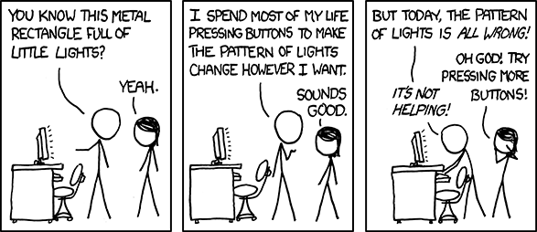

Slide 2
Operator Overloading
Zybooks 7.10
The Complete Reference C++ Chapter 15

Slide 3
Operator Overloading
Allows a programmer to redefine the functionality of a built in operator
Can be used to simplify syntax and functionality of your program
Used mainly in the context of the class

Slide 4
Operator Overloading
Creating a Member operator Function
Part 1: Class Prototype:
type operator+(arguments);
Return Type
Operator to change
Arguments needed to do the job

Slide 5
Operator Overloading
Creating a Member operator Function
Part 1: Class Prototype:
Part 2: Implementation
type class::operator+(argument_type var){
return type_val;
}
Return Type
Class Name
Operator to change
Arguments needed to do the job

Slide 6
Operator Overloading
Creating a Member operator Function
Part 1: Class Prototype:
Part 2: Implementation
type class::operator+(argument_type var){
return type_val;
}
Must Match

Slide 7
Operator Overloading
Example: Boolean == : Prototype
class location{
private:
double lon; // longitude
double lat; // latitude
public:
location(); //Constructor
location(double, double);//Constructor
bool operator==(location);
};

Slide 8
Operator Overloading
Example: Boolean == : Implementation
bool location::operator==(loc rhs)
{
if(lat == rhs.lat && lon == rhs.lon)
return true;
return false;
}

Slide 9
Operator Overloading
Example: Boolean == : Usage
int main()
{
location point1(30,60);
location point2(30,60);
if(point1 == point2)
cout << “Equal” <<endl;
else
cout << “Not Equal” << endl;
return 0;
}

Slide 10
Operator Overloading
Example: +: Prototype
class location{
private:
double lon; // longitude
double lat; // latitude
public:
location(); //Constructor
location(double, double);//Constructor
location operator+ (location );
};

Slide 11
Operator Overloading
Example: +: Implementation
location location::operator+(location rhs)
{
location temp;
temp.lat = lat + rhs.lat;
temp.lon = lon + rhs.lon;
return temp;
}

Slide 12
Operator Overloading
Example: +: (another) Implementation
location location::operator+(location rhs)
{
lat = lat + rhs.lat;
lon = lon + rhs.lon;
return *this;
}
NOTE: THIS WILL ALTER THE OBJECT ON THE LEFT SIDE OF THE +

Slide 13
Operator Overloading
Example: +: Usage
int main()
{
location point1(30,60);
location point2(30,60);
location point3 = point1 + point2;
}

Slide 14
Operator Overloading
Operator using friend functions
Overloading an operator for a class using a non-member function
Example: Prototype:
class location{
private:
double lon; // longitude
double lat; // latitude
public:
location(); //Constructor
location(double, double);//Constructor
friend location operator+ (location, location);
};

Slide 15
Operator Overloading
Operator using friend functions
Overloading an operator for a class using a non-member function
Example: Implementation:
location operator+(location lhs, location rhs)
{
location temp;
temp.lat = lhs.lat + rhs.lat;
temp.lon = lhs.lon + rhs.lon;
return temp;
}

Slide 16
Operator Overloading
Operator using friend functions
Overloading an operator for a class using a non-member function
Example: Implementation:
int main()
{
location point1(30,60);
location point2(30,60);
location point3 = point1 + point2;
}

Slide 17
Operator Overloading
Operating using friend functions.
Why? – Flexibity
When you overload a function traditionally that takes a regular data type (int, double, float, …) the order matters:
location point1 = point2 + 3.0; // Works
location point1 = 3.0 + point2; // Error

Slide 18
Operator Overloading
Operating using friend functions.
Why? – Flexibity
When you overload a function using friend functions, the order does not matter
location point1 = point2 + 3.0; // Works
location point1 = 3.0 + point2; // Works

Slide 19
Operator Overloading
Operating using friend functions.
Why? – you can write a display function but call it within a cout statement (more intuitive)
class location{
private:
double lon; // longitude
double lat; // latitude
public:
location(); //Constructor
location(double, double);//Constructor
location operator+ (location);
friend ostream& operator << (ostream&, location&);
};

Slide 20
Operator Overloading
Operating using friend functions.
Why? – you can write a display function but call it within a cout statement (more intuitive)
ostream& operator<<(ostream& os, location& rhs)
{
os << “(“ << rhs.lat << “,” << rhs.lon <<“)”;
return os;
}

Slide 21
Operator Overloading
Operating using friend functions.
Why? – you can write a display function but call it within a cout statement (more intuitive)
int main(){
location point1(30,60);
location point2(45,55);
cout << point1 << endl;
cout << point2 << endl;
}

Slide 22
Operator Overloading
Overloading ++ and – (for prefix and postfix)
Traditional
//prefix
class class::operator++(){
//Stuff
return *this;
}
class class::operator--(){
//Stuff
class *this;
}
++i

Slide 23
Operator Overloading
Overloading ++ and – (for prefix and postfix)
Friend
//prefix
class operator++(class & lhs){
//Stuff
return lhs;
}
class operator--(class &lhs){
//Stuff
return lhs;
}
++i

Slide 24
Operator Overloading
Overloading ++ and – (for prefix and postfix)
Traditional
//postfix
class class::operator++(int x){
//Stuff
return *this;
}
class class::operator--(int x){
//Stuff
class *this;
}
i++

Slide 25
Operator Overloading
Overloading ++ and – (for prefix and postfix)
Friend
//postfix
class operator++(class &lhs, int x=0){
//Stuff
return lhs;
}
class operator--(class &lhs, int x=0){
//Stuff
return lhs;
}
i++

Slide 26
Operator Overloading
Determining which function is invoked (Match)
Given
Course crs1;
Course crs2;
int num1;
int num2;
num2 + crs2;
crs1 + crs2;
num1 + num2;
crs1 + num1;
Course Course::operator+(int val)
Course Course::operator+(Course rhs)
Built-in + operation
None of the above

Slide 27
Operator Overloading
Determining which function is invoked (Match)
Given
Course crs1;
Course crs2;
int num1;
int num2;
num2 + crs2;
crs1 + crs2;
num1 + num2;
Course Course::operator+(int val)
Course Course::operator+(Course rhs)
Built-in + operation
None of the above
crs1 + num1;

Slide 28
Operator Overloading
Determining which function is invoked (Match)
Given
Course crs1;
Course crs2;
int num1;
int num2;
num2 + crs2;
num1 + num2;
Course Course::operator+(int val)
Course Course::operator+(Course rhs)
Built-in + operation
None of the above
crs1 + num1;
crs1 + crs2;

Slide 29
Operator Overloading
Determining which function is invoked (Match)
Given
Course crs1;
Course crs2;
int num1;
int num2;
Course Course::operator+(int val)
Course Course::operator+(Course rhs)
Built-in + operation
None of the above
crs1 + num1;
crs1 + crs2;
num1 + num2;
num2 + crs2;

Slide 30
Operator Overloading
Overloading Special Operators: [] – Can represent a function or even act as an array index for Linked Data Structures. (This method only works when the [] is on the right of the = sign )
Prototype:
type operator[](argument)
Implementation:
type class ::operator[](argument)
{
// ...
}

Slide 31
Operator Overloading
Overloading Special Operators[] – Can represent a function or even act as an array index for Linked Data Structures.
Usage:
variable = class_object[argument];

Slide 32
Operator Overloading
Overloading special Operators:[] – Example
Custom Array Class:
class atype{
private:
int a[3];
public:
atype(int i, int j, int k){
a[0] = i;
a[1] = j;
a[2] = k;
}
int operator[](int);
};

Slide 33
Operator Overloading
Overloading special Operators:[] – Example
Implementation:
int atype::operator[](int index)
{
return a[index];
}

Slide 34
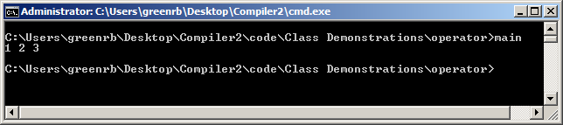
Operator Overloading
Overloading special Operators:[] – Example
Usage:
int main()
{
atype array(1,2,3);
cout << array[0] <<“ “<< array[1] <<“ “<< array[2] <<endl;
return 0;
}

Slide 35
Operator Overloading
Overloading Special Operators:[] – In order for the overloaded [] to operate on both sides of the equal sign
Prototype:
int &operator[](int)
Implementation:
int &class :: operator[](int index)
{
// ...
}

Slide 36
Operator Overloading
Overloading Special Operators:[] – In order for the overloaded [] to operate on both sides of the equal sign
Usage:
variable = class_object[argument];
class_object[argument] = variable;

Slide 37
Operator Overloading
Overloading special Operators:[] – Example
Custom Array Class:
class atype{
private:
int a[3];
public:
atype(int i, int j, int k){
a[0] = i;
a[1] = j;
a[2] = k;
}
int &operator[](int);
};

Slide 38
Operator Overloading
Overloading special Operators:[] – Example
Implementation:
int &atype::operator[](int index)
{
return a[index];
}

Slide 39
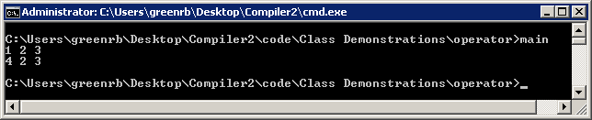
Operator Overloading
Overloading special Operators:[] – Example
Usage:
int main()
{
atype array(1,2,3);
cout << array[0] <<“ “<< array[1] <<“ “<< array[2] <<endl;
atype[0] = 4;
cout << array[0] <<“ “<< array[1] <<“ “<< array[2] <<endl;
return 0;
}

Slide 40
Operator Overloading
Overloading Special Operator: () – Can allow you to set multiple members in a function without use of set functions.
Instead of player.setFirstName(“First”); and player.setLastName(“Last”); you can use:
player(“First”,”Last”);

Slide 41
Operator Overloading
Overloading Special Operators: ()
Prototype:
type operator()(argument)
Implementation:
type class :: operator()(argument)
{
// ...
}

Slide 42
Operator Overloading
Overloading Special Operators: ()
Usage:
class_object(arguments);

Slide 43
Operator Overloading
Overloading special Operators:() – Example
Custom Array Class:
class atype{
private:
int a[3];
public:
atype(int i, int j, int k){
a[0] = i;
a[1] = j;
a[2] = k;
}
atype operator()(int, int, int);
int &operator[] (int);
};

Slide 44
Operator Overloading
Overloading special Operators:() – Example
Implementation:
atype atype::operator()(int i,int j, int k)
{
a[0] = i;
a[1] = j;
a[2] = k;
return *this;
}

Slide 45
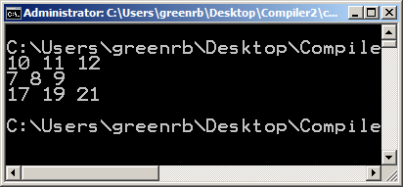
Operator Overloading
Overloading special Operators() – Example
Usage:
int main()
{
atype arr1(1,2,3);
atype arr2(4,5,6);
arr1(10,11,12); // By itself
atype arr3 = arr1 + arr2(7,8,9); // can be used in expressions
cout << arr1[0] <<" " << arr1[1] << " " << arr1[2] << endl;
cout << arr2[0] <<" " << arr2[1] << " " << arr2[2] << endl;
cout << arr3[0] <<" " << arr3[1] << " " << arr3[2] << endl;
}

Slide 46
Operator Overloading
Overloading operator ->:
Must return a pointer to an object of the class that the operator -> belongs.
The element used with the overloaded -> operator must belong to the public section of the class
Prototype:
class *operator->()
Implementation
class *class::operator->()
{
return this;
}

Slide 47
Operator Overloading
Overloading operator ->:
Usage:
class_object->public_member;

Slide 48
Operator Overloading
Overloading special Operators:() – Example
Custom Array Class:
class atype{
public:
int a[3];
atype(int i, int j, int k){
a[0] = i;
a[1] = j;
a[2] = k;
}
atype *operator->();
};

Slide 49
Operator Overloading
Overloading special Operators:() – Example
Implementation:
atype *atype::operator()(
{
return this;
}

Slide 50
Operator Overloading
Overloading special Operators() – Example
Usage:
int main()
{
atype arr1(1,2,3);
atype arr2(4,5,6);
arr1(10,11,12); // By itself
atype arr3 = arr1 + arr2(7,8,9); // can be used in expressions
cout << arr1->a[0] <<" " << arr1->a[1] << " " << arr1->a[2] << endl;
cout << arr2->a[0] <<" " << arr2->a[1] << " " << arr2->a[2] << endl;
cout << arr3->a[0] <<" " << arr3->a[1] << " " << arr3->a[2] << endl;
}

Slide 51
Operator Overloading
Overloading comma operator , :
You can make the comma operator perform anything you want. HOWEVER if you want it to perform similarly to normal operation, then you must discard the values of all arguments except the rightmost (because this is how C++ operates)
Prototype:
type operator,(argument)
Implementation
type class::operator,(argument)
{
//Stuff
return type_variable;
}

Slide 52
Operator Overloading
Overloading special Operators:() – Example
Custom Array Class:
class atype{
public:
int a[3];
atype(int i, int j, int k){
a[0] = i;
a[1] = j;
a[2] = k;
}
atype operator, (atype);
int operator[] (int);
};

Slide 53
Operator Overloading
Overloading special Operators:() – Example
Implementation:
atype atype::operator,(atype rhs)
{
atype temp;
temp.a[0] = rhs.a[0];
temp.a[1] = rhs.a[1];
temp.a[2] = rhs.a[2];
}

Slide 54
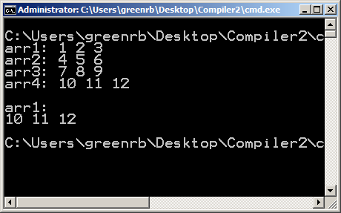
Operator Overloading
Overloading special Operators() – Example
Usage:
int main()
{
atype arr1(1,2,3);
atype arr2(4,5,6);
atype arr3(7,8,9);
atype arr4(10, 11, 12);
cout <<"arr1: "<< arr1[0] <<" " << arr1[1] << " " << arr1[2] << endl;
cout <<"arr2: "<< arr2[0] <<" " << arr2[1] << " " << arr2[2] << endl;
cout <<"arr3: "<< arr3[0] <<" " << arr3[1] << " " << arr3[2] << endl;
cout <<"arr4: "<<arr4[0] <<" " << arr4[1] << " " << arr4[2] << endl;
arr1 = (arr2, arr3, arr4);
cout<<endl << "arr1: "<< arr1[0] <<" " << arr1[1] << " " << arr1[2] << endl; }

Slide 55

Operator Overloading
Questions?
class loc {
private:
double lat;
double lon;
public:
loc(double lat_r = 0, double lon_r = 0);
loc operator+(loc rhs);
void Print();
};
loc loc::operator+(loc rhs)
{
loc total;
total.lat = lat + rhs.lat;
total.lon = lon + rhs.lon;
return total;
}
Given loc pt1(30,45) and loc pt2(23,50), what is ptTot.lat after
ptTot = pt1 + pt2; ?

Slide 56
Operator Overloading
Questions?
class loc {
private:
double lat;
double lon;
public:
loc(double lat_r = 0, double lon_r = 0);
loc operator+(loc rhs);
void Print();
};
loc loc::operator+(loc rhs)
{
loc total;
total.lat = lat + rhs.lat;
total.lon = lon + rhs.lon;
return total;
}
Given loc pt1(30,45) and loc pt2(23,50), what is ptTot.lat after
ptTot = pt1 + pt2; ?
53

Slide 57
Operator Overloading
Questions?
class loc {
private:
double lat;
double lon;
public:
loc(double lat_r = 0, double lon_r = 0);
loc operator+(loc rhs);
void Print();
};
loc loc::operator+(loc rhs)
{
loc total;
total.lat = lat + rhs.lat;
total.lon = lon + rhs.lon;
return total;
}
Write the start of a loc member function definition that overloads the – operator, naming the parameter rhs

Slide 58
Operator Overloading
Questions?
class loc {
private:
double lat;
double lon;
public:
loc(double lat_r = 0, double lon_r = 0);
loc operator+(loc rhs);
void Print();
};
loc loc::operator+(loc rhs)
{
loc total;
total.lat = lat + rhs.lat;
total.lon = lon + rhs.lon;
return total;
}
Write the start of a loc member function definition that overloads the – operator, naming the parameter rhs
loc loc::operator-(loc rhs)

